Slide 1
Wireless Transmission
Unguided Transmission Media

Slide 2
Wireless Transmission
Three techniques:
Microwave
Terrestrial Microwave
Satellite Microwave
Broadcast Radio
Infrared

Slide 3
Wireless Transmission Frequencies
Three range of frequencies are considered here:
1GHz(10⁹ Hz )to 40GHz
Referred as Microwave frequencies
Highly directional beams are possible
Suitable for Point to point transmission
Satellite
30MHz to 1GHz
Microwave frequency
Used for Omnidirectional applications
Also referred as radio range
Suitable for Broadcast radio
3 x 10¹¹ to 2 x 10¹⁴ Hz
Infrared portion of the spectrum
Local i.e for point-to-point and multi-point application within confined areas such as single room

Slide 4
Wireless Transmission
For unguided media ,transmission and reception are achieved by means of an antenna

Slide 5
Antennas
Antenna is an electrical conductor (or system of conductors) used to radiate electromagnetic energy or collect electromagnetic energy
Transmission
energy from transmitter is converted to electromagnetic energy by the antenna
Radiated into surrounding environment(atmosphere,space or water)
Reception
Electromagnetic energy impinging on antenna is
converted to radio frequency electrical energy
Fed to receiver
For two way communication same antenna often used for both transmission and reception

Slide 6
Antenna
Radiation Pattern:Power radiated in all directions
Not same performance in all directions
Common way to characterize the antenna is its radiation pattern
Isotropic antenna is (theoretical) point in space
Idealized antenna
Radiates in all directions equally
Gives spherical radiation pattern with antenna at the center

Slide 7
Parabolic Reflective Antenna
Used for terrestrial and satellite microwave transmission
Parabola is locus of point equidistant from a line and a point not on that line
Fixed point is called focus
Fixed line is called directrix
Revolve parabola about axis to get paraboloid
Cross section parallel to axis gives parabola
Cross section perpendicular to axis gives circle

Slide 8
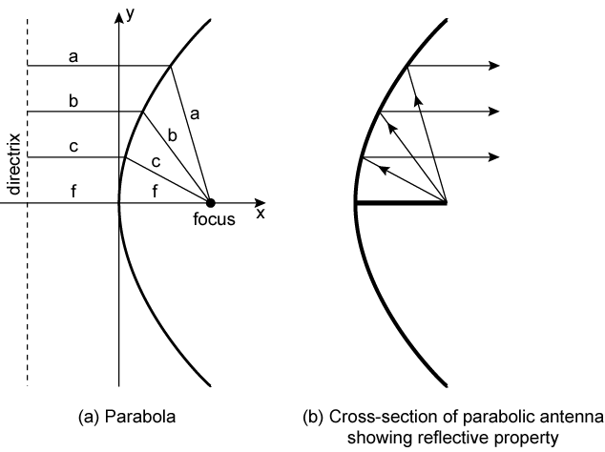
Parabolic Reflective Antenna

Slide 9
Parabolic Reflective Antenna
Such surfaces are used in microwave antennas due to the following property:
If source of electromagnetic energy is placed at focus and if the paraboloid is a reflecting surface ,then waves get reflected from parabola in lines parallel to axis of paraboloid
Creates (theoretical) parallel beam of light/sound/radio,but in reality there will be certain dispersion
On reception,if incoming waves are parallel to the axis of reflecting paraboloid,the resulting signal will be concentrated at focus, where detector is placed

Slide 10
Antenna Gain
Measure of directionality of antenna
Definition:
Power output, in particular direction ,compared to that produced in any direction by isotropic antenna(omnidirectional)
Measured in decibels (dB)
Due to increased power radiated in a given direction thereby results in loss in power in another direction

Slide 11
Antenna Gain and Effective Area
Relationship between antenna gain and effective area
G = antenna gain
A_{e} = effective area
f = carrier frequency
c = speed of light (» 3 ´ 10⁸ m/s)
λ = carrier wavelength

Slide 12
Terrestrial Microwave
Physical Description
Common microwave antenna is the “Parabolic dish”
Size is about 3 m in diameter
The antenna is fixed rigidly and focuses a narrow beam
Line-of-sight transmission is achieved to the receiving antenna
Antennas are located at substantial heights above ground level
To extend the range between antennas and to be able to transmit over intervening obstacles
To achieve long distance transmission ,a series of microwave relay towers is used and point-to-point links are strung together

Slide 13
Terrestrial Microwave
Applications
Primary use in long haul telecommunication service
as an alternative to coaxial cable or optical fiber
Used for voice and television transmission
Used for short point-to-point links between buildings
Used in cellular systems

Slide 14
Terrestrial Microwave
Transmission characteristics
Common frequencies used for transmission are in the range 1 to 40 GHz
Higher the frequency ,the higher the potential bandwidth and therefore the higher the potential data rate
The main source of loss is attenuation
The loss is expressed as:
L=10 log (4πd/λ)² dB
Where d is the distance and λis the wavelength ,in the same units
i.e loss varies as a square of distance

Slide 15
Terrestrial Microwave
Therefore large repeater spacing is needed -10 to 100 km
Attenuation increases with rainfall
Another source of impairment is interference
Transmission areas overlap and interference is always a danger
Assignment of frequency bands is strictly regulated

Slide 16
Satellite Microwave
A communication satellite is a relay station
Used to link two or more ground-based microwave transmitters/receivers,known as earth stations
Satellite receives on one frequency band(uplink), amplifies or repeats signal and transmits on another frequency band(downlink)
A single orbiting satellite will operate on a number of frequency bands ,called transponder channel or simply transponders
Two common configurations in satellite communication is as follows:

Slide 17
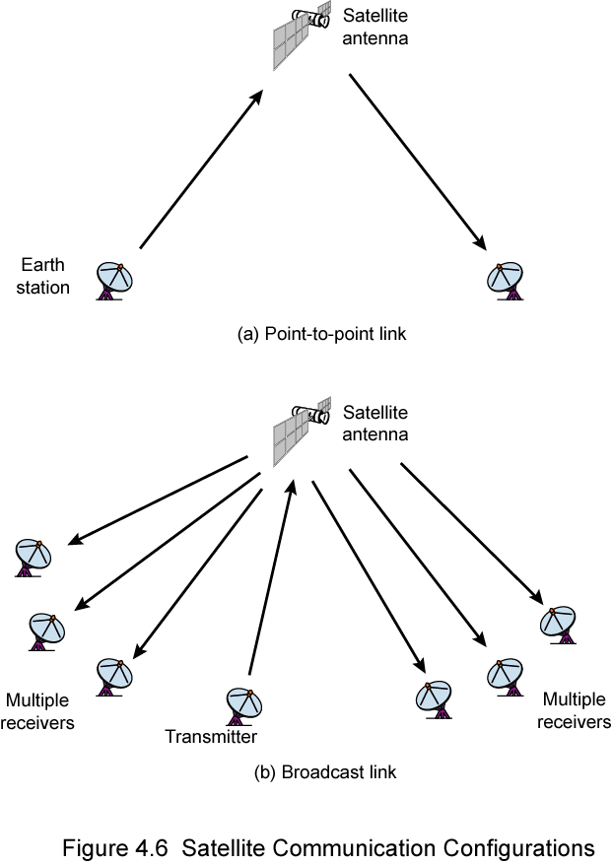
Satellite Point to Point Link

Slide 18
Satellite Broadcast Link

Slide 19
Satellite Microwave
In the first ,the satellite is being used to provide a point-to-point link between two distant ground based antennas
In the second,the satellite provides communications between one ground based transmitter and a number of ground based receivers

Slide 20
Satellite Microwave
To work effectively,satellite requires geo-stationary orbit
Height of 35,784km
i.e. the period of rotation of satellite will be equal to period of rotation of earth
Otherwise it will not be at line of sight with the earth station at all times

Slide 21
Satellite Microwave
Two satellites using the same frequency bands ,if close to each other ,will interfere with each other
To avoid this a 4º spacing (angular displacement as measured from earth) in the 4/6-GHz band and 3º spacing at 12/14 GHz

Slide 22
Satellite Microwave
Applications
Television
Long distance telephone
Private business networks

Slide 23
Satellite Microwave
Transmission characteristics
Frequency range in satellite communication is 1 to 10 GHz
Below 1 GHz there is significant noise from natural sources
Above 10 GHz the signal is severely attenuated by atmospheric absorption and precipitation

Slide 24
Satellite Microwave
Disadvantages
Because of the long distance involved ,there is a propagation delay(about a quarter second)
Also introduces problems in error control and flow control
Satellite is inherently broadcast facility

Slide 25
Satellite Microwave
Types of frequency bands:
4/6
Uplink frequency:5.925 to 6.425
Downlink frequency:3.7 to 4.2 GHz
12/14
Uplink frequency:14 to 14.5GHz
Downlink frequency:11.7 to 12.2 GHz
20/30
Uplink frequency:27.5 to 30.0GHz
Downlink frequency:17.7 to 20.2 GHz

Slide 26
Broadcast Radio
Physical description
Omnidirectional
So it does not require dish shaped antenna
Applications
FM radio
UHF and VHF television
Radio:Frequency range is 3kHz to 300GHz
Broadcast radio:cover VHF and part of UHF band i.e. 30MHz to 1 GHz

Slide 27
Broadcast Radio
Transmission characteristics
The range 30MHz to 1 GHz is an effective one for broadcast communication
The ionosphere is transparent to this frequency range
Transmission is limited to the line- of- sight
Distant transmitters will not interfere with each other due to reflection from the atmosphere
Broadcast radio waves are less sensitive to attenuation from rainfall
Because of the longer wavelength ,radiowaves suffer relatively less attenuation

Slide 28
Broadcast Radio
Disadvantage
Primary source of impairments in radio waves is multipath interference
Reflection from land ,water and natural or human made objects can create multiple paths between antennas

Slide 29
Infrared
Infrared communicatins achieved using transmitters /receivers(transceiver) that modulate noncoherent infrared light
Transcievers must be within Line-of-sight of each other directly or via reflection from light-coloured surface such as ceiling of a room
Blocked by walls(while microwave penetrate through walls)
e.g. TV remote control

Slide 30
Wireless Propagation
A Signal radiated from an antenna travels along one of three routes
Ground wave
Sky wave
Line- of -sight
Above 30Mhz
May be further than optical line of sight due to refraction
More later…

Slide 31
Ground Wave Propagation
Ground wave
Signal follows contour of earth i.e the curvature of the earth
Effect can be found in frequencies up to 2MHz
AM radio

Slide 32
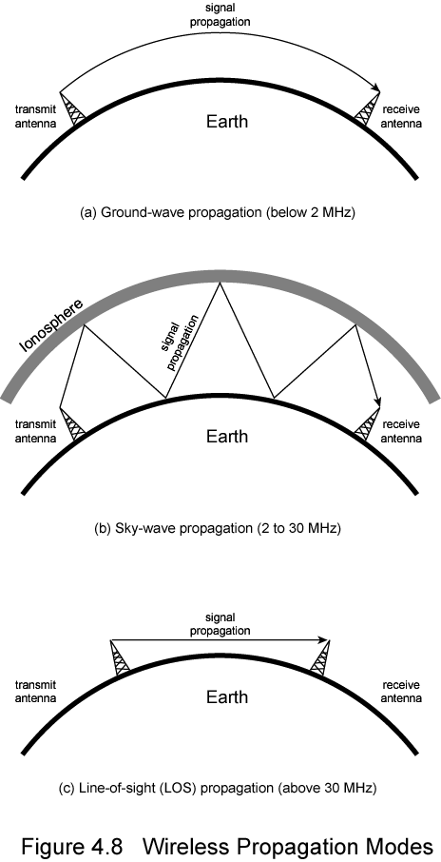
Ground Wave Propagation

Slide 33
Sky Wave Propagation
Sky wave
Amateur radio, BBC world service, Voice of America
Signal from an earth based antenna is reflected from ionosphere layer of upper atmosphere(ionosphere) back to the earth
Actually it is refraction
Signal an travel through a number of hops ,bouncing back between ionosphere and earth’s surface
With this propagation mode ,a signal can be picked up thousands of kilometers from the transmitter.

Slide 34
Sky Wave Propagation

Slide 35
Line- of -sight
Line- of -sight
Above 30MHz
May be further than optical line of sight due to refraction
For satellite communication as well as ground based communication ,transmitter and receiver must be within effective line of sight of each other

Slide 36
Line of Sight Propagation

Slide 37
Refraction
Velocity of electromagnetic wave is a function of density of material
~3 x 10⁸ m/s in vacuum, less in anything else
As wave moves from one medium to another, its speed changes
Causes bending of direction of wave at boundary
Towards more dense medium
Index of refraction (refractive index) is
Sin(angle of incidence)/sin(angle of refraction)
Varies with wavelength
May cause sudden change of direction at transition between media
May cause gradual bending if medium density is varying
Density of atmosphere decreases with height
Results in bending towards earth of radio waves

Slide 38
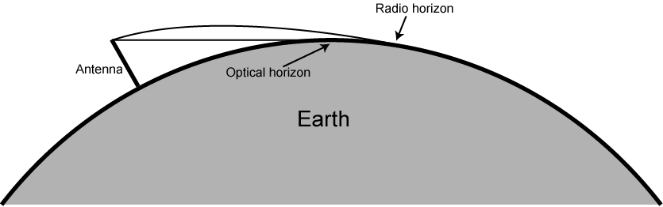
Optical and Radio Horizons

Slide 39
Line of Sight Transmission
Free space loss
Signal disperses with distance
Greater for lower frequencies (longer wavelengths)
Atmospheric Absorption
Water vapour and oxygen absorb radio signals
Water greatest at 22GHz, less below 15GHz
Oxygen greater at 60GHz, less below 30GHz
Rain and fog scatter radio waves
Multipath
Better to get line of sight if possible
Signal can be reflected causing multiple copies to be received
May be no direct signal at all
May reinforce or cancel direct signal
Refraction
May result in partial or total loss of signal at receiver

Slide 40
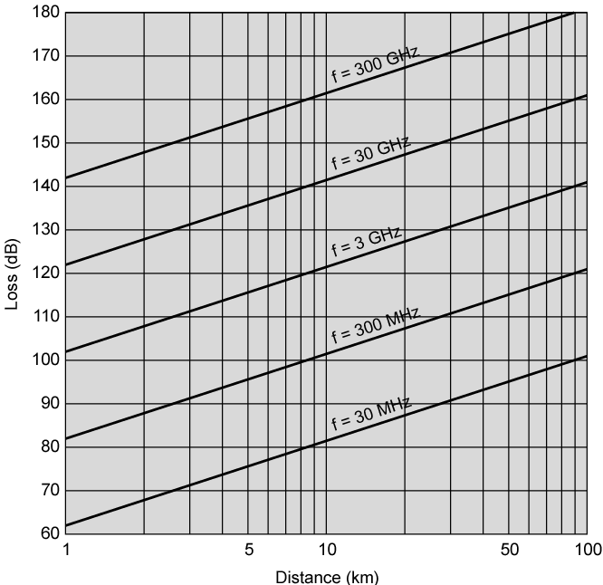
Free Space Loss

Slide 41
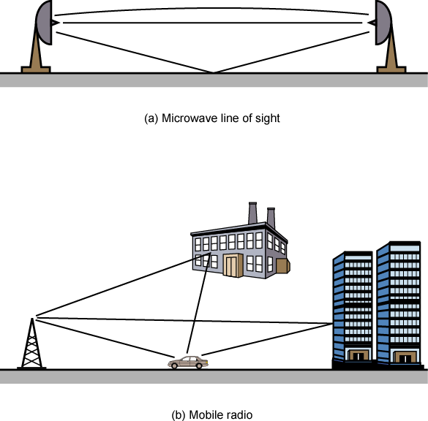
Multipath Interference

